Slide 1

Introduction To Distributed Systems
Dr. Zainab Hassan Ali
Lecturer at the Department of Embedded Network and Technology, Faculty of Artificial Intelligence, Kafrelsheikh University
Email: zainabhassan@ai.kfs.edu.eg

Slide 2
In This Chapter
Network Types: Overview.
What is the Distributed Systems?
What is the Operating System.
Middleware System.
Design Goals of Distributed System.
Supporting resource sharing.
Distributed transparency.
Openness.
Scalability.
Challenges of Distributed system.

Slide 3
PART 2

Slide 4
Overview

Slide 5
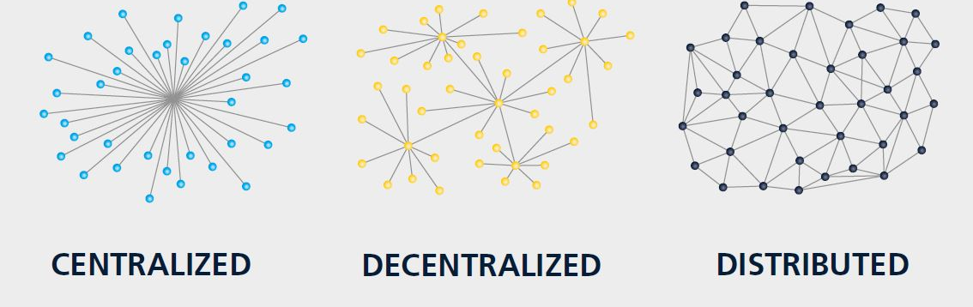
Network Types: Overview

Slide 6
Distributed System

Slide 7
What’s the Distributed Systems?
Definition
Distributed system is a collection of autonomous computing elements that appears to its users as a single coherent system.
Autonomous computing elements are referred to as nodes, be they hardware devices and software process.
Single coherent system users or applications perceive a single system nodes need to collaborate.

Slide 8
What’s the Distributed Systems?
What’s the autonomous System (AS)?
An autonomous system (AS) in networking is a collection of one or more associated Internet Protocol (IP) prefixes with a clearly defined routing policy that governs how the AS exchanges routing information with other autonomous systems. In simpler terms, an AS can be thought of as a connected group of IP networks managed by a single administrative entity, such as a university, government, commercial organization or other type of internet service provider (ISP).

Slide 9
Collection of Autonomous Elements
Means
Autonomous behaviour Independent behaviour nodes
There is no global clock notion.
Synchronization issue.

Slide 10


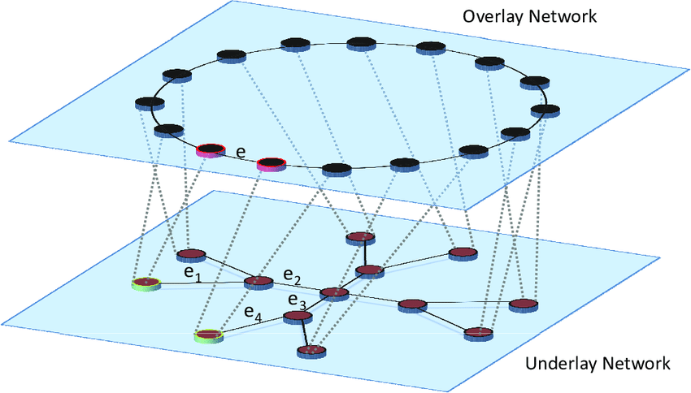
Collection of Autonomous Elements-Cont.
How to organize the membership group of distributed system?
Structured
Overlay Network
Unstructured
Definition
Overlay network is a telecommunications network that is built on top of another existing network (P2P system is an good example of overlay network).
Overlay network adds an additional layer of indirection/virtualization.

Slide 11
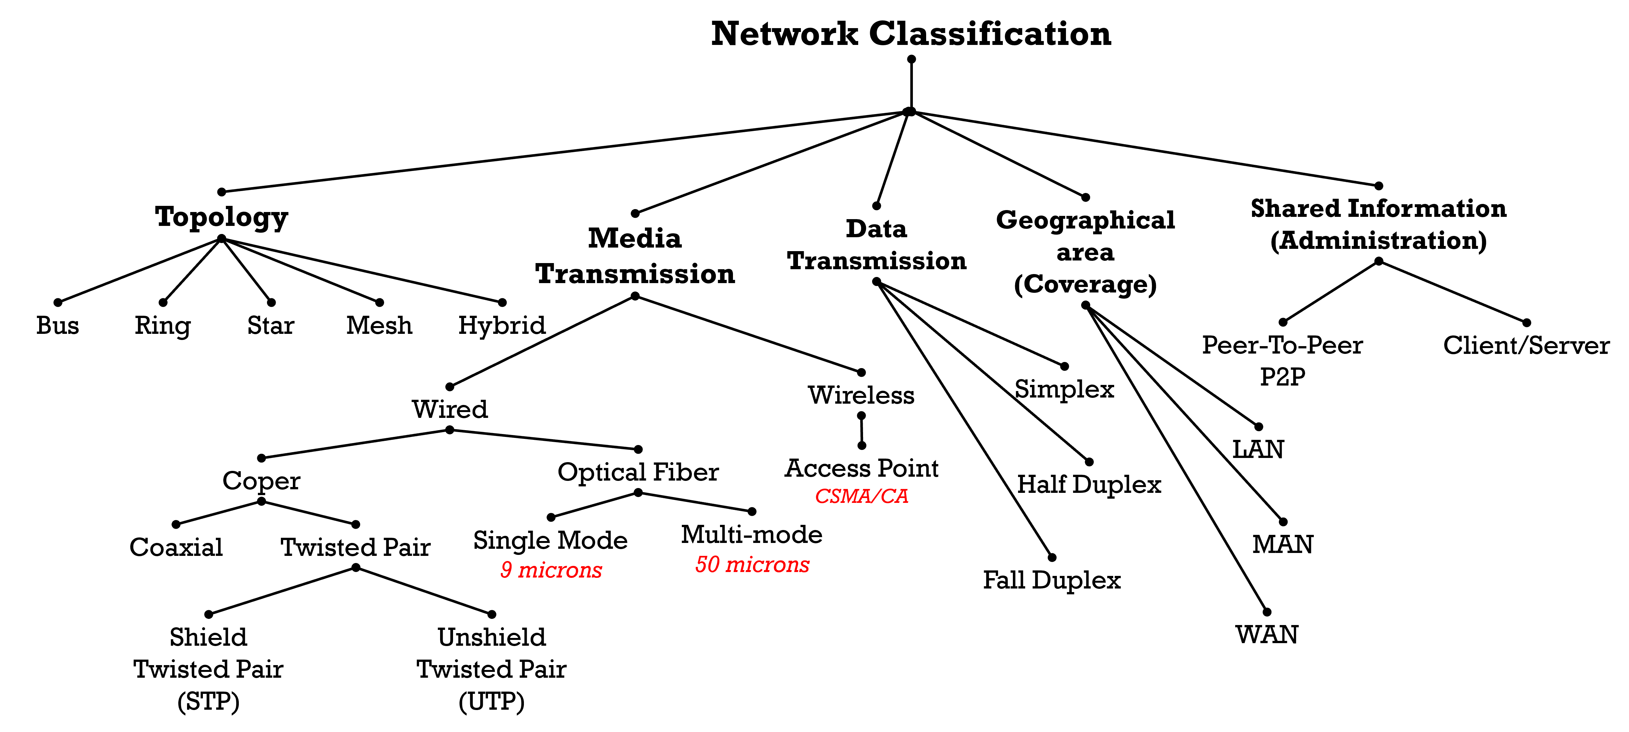
Collection of Autonomous Elements-Cont.
Underlay Network Overview:

Slide 12
Distributed System is a Coherent System
The collection of nodes as a whole operates the same, no matter where, when, and how interaction between a user and the system takes place.
According to cloud computing system, the coherent system is referred to ubiquitous operation
Examples
The users can’t tell where a computation is taking place.
Where data exactly stored should be irrelevant to an application.
If or not data has been replicated is completely hidden.
Keyword generated is “Distributed Transparency”

Slide 13
Operating System
&
Middleware

Slide 14
What’s the O.S.
O.S Definition
An operating system is software that uses the hardware resources of a computer system to provide support for the execution of other software.
Kernel is a core of the operating system.
* Linux:-
The Linux kernel provides the basic operating system services through an API.
Shells are the programs such as bash that interpret typed commands.
Desktop environments are the programs, such as KDE (K Desktop Environment) and GNOME, that handle graphical interaction.
* Microsoft windows:-
The kernel is the fundamental portion of Microsoft Windows that provides an API supporting computations with controlled interactions.

Slide 15
What’s the O.S. – Cont.
O.S. Functions
The O.S. allows multiple computations to take place concurrently on a single computer system.
The O.S. divides the hardware’s time between the computations and handles the shifts of focus between the computations, keeping track of where each one leaves off so that it can later correctly resume.
The O.S. controls the interactions between the concurrent computations. It can enforce rules, such as forbidding computations from modifying data structures.

Slide 16
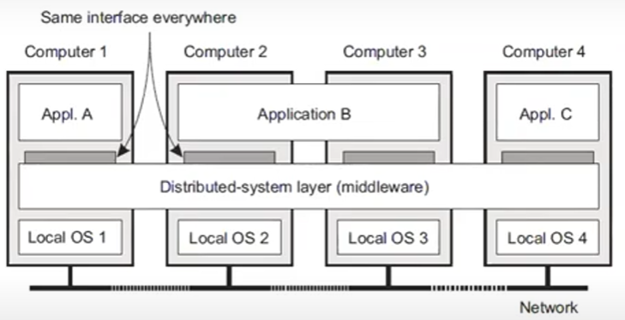
Middleware: O.S in the DS.

Slide 17
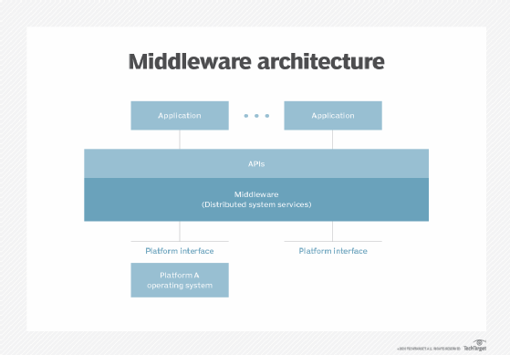
Middleware: O.S in the DS.- Cont.
Definition
Middleware is software that provides common services and capabilities to applications outside of what’s offered by the operating system. Data management, application services, messaging, authentication, and API management are all commonly handled by middleware.
In the distributed system, Middleware works as a OS in the computer device.

Slide 18
Middleware: O.S in the DS.- Cont.
Middleware Services:
Communication between different nodes and multiple O.S.
Transaction (distributed DB/Distributed information system).
Service Composition (Web services).
Reliability.

Slide 19
Distributed System
Goals

Slide 20
What are the goals of the DS.?
The design goals of the DS.:
Support sharing resources.
Distributed transparency.
Openness.
Scalability.

Slide 21
What are the goals of the DS.? Cont.
* Support Sharing Resources:
Cloud-based shared storage and files.
P2P assisted multimedia streaming.
Shared mail services.
Shared web hosted.
Keyword: “the Network is the Computer”

Slide 22
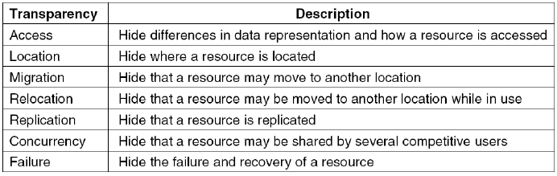
What are the goals of the DS.? Cont.
* Distributed Transparency:

Slide 23
What are the goals of the DS.? Cont.
* Openness:
The openness of the distributed system is determined primarily by the degree to which new resource-sharing services can be made available to the users.
Open systems are characterized by the fact that their key interfaces are published. It is based on a uniform communication mechanism and published interface for access to shared resources. It can be constructed from heterogeneous hardware and software.
Keyword: “Interoperability”

Slide 24
What are the goals of the DS.? Cont.
* Openness:
The system able to interact with services from other open systems, irrespective of the underlying environment:
Systems should conform to well-defined interfaces.
Systems should support portability of applications.
Systems should easily interoperate.

Slide 25
What are the goals of the DS.? Cont.
* Implementation of Openness: Policies
Policies should be defined by the distributed system.
What ‘s the level of consistency do we require for client-cached data?
Which operation do we allow downloaded code to perform?
Which QoS requirements de we adjust in the face of varying bandwidth?
What level of secrecy do we require for communication?

Slide 26
What are the goals of the DS.? Cont.
* Scalability:
A distributed system running on a collection of a small number of machines can be easily extended to a large number of machines to increase the processing power.
*Three parameters are required to achieve system scalable:
Number of users and/or processes (size scalability).
Maximum distance between nodes (geographical scalability).
Number of administrative domains (administrative scalability).

Slide 27
What are the goals of the DS.? Cont.
* Scalability problems with the centralized solutions:
*There are different parameters should be considered to maintains scalability:
The computational capacity and CPUs limitations.
The storage capacity, include the transfer rate between CPU and disk.
The network between the users and the centralized systems.

Slide 28

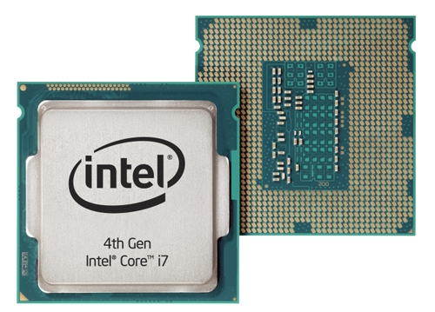
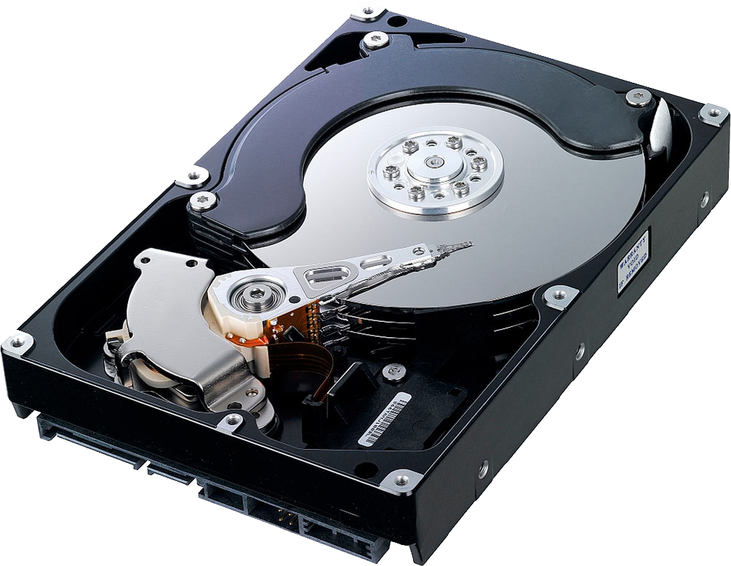

What are the goals of the DS.? Cont.
*How can make the system scalable?
Scale out
Scale up
System expansion via adding a set of PCs.
Improve system capacity
Resources/HW
Server-1
Server-2
Server-3

Slide 29
What are the goals of the DS.? Cont.
*How can make the system scalable?
Scale out
Scale up
Hiding communication latency (support asynchronous communication).
Improve system capacity
Resources/HW

Slide 30
What are the goals of the DS.? Cont.
*The benefits of build a scale System
Hide communication latencies: Avoid waiting for responses.
Distribution: Partition data and computations across multiple nodes:
1-Move computations to clients (Java applets).
2-Decentralized naming services (DNS).
3-Decentralized information systems (WWW).
Replication/caching: Make copies of data available at different nodes:
1- Replicated file servers and databases
2- Mirrored Web sites
3- Web caches (in browsers and proxies)
4- File caching (at server and client)

Slide 31
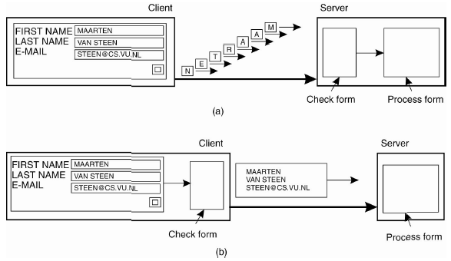
What are the goals of the DS.? Cont.
Example of Scale system (Hiding latency)

Slide 32
Distributed System Challenges

Slide 33
Challenges of DS
There are a set of challenges in the DS.
Network is not reliable.
Heterogeneous network.
Network latency.
Varying network bandwidth.
Security.

Slide 34
Reference
[1] WEIJIA JIA, ANLEI ZHOU. “DISTRIBUTED NETWORK SYSTEMS”, Springer Science + Business Media, Inc. 2005

Slide 35
Report 1
What are the purposes of distributed systems?
What are the fundamental components of distributed computing systems?
What is the openness and give some example?
What is the definition of interoperability?
List scalability components.

Slide 36
Activity 2
Read the following paper:
Mahmoud M Badawy, Zainab H Ali, Hesham A Ali, QoS provisioning framework for service-oriented internet of things (IoT), Cluster Computing, Springer. 2020

Slide 37
Thank You

